Slide 1
Rural and Urban Population & Decadal Change (2011 Census)
Comprehensive Data Analysis & Key Insights
Name : K VENKAIAH SWAMY
Source : https://www.data.gov.in/
Email: venkaiahswamy462@gmail.com
Linkedin:
Phone: 9391323528

Slide 2
Introduction
This dataset provides insights into rural and urban population distribution.
It helps analyze urbanization trends, demographic shifts, and population growth.
Data is based on the 2011 Census and includes decadal change statistics.

Slide 3
Key Features
Detailed population statistics for rural and urban areas.
Gender-wise breakdown of population data.
Decadal growth trends for urbanization analysis.
Useful for policy-making, research, and economic planning.

Slide 4
Dataset Columns Breakdown
Taluks: Names of administrative regions.
Population 2011: Rural and urban counts, separated by gender.
Total Population 2011: Combined rural and urban population.
Decadal Change Percentage: Growth trends from 2001 to 2011.

Slide 5
Use Cases of the Dataset
Government planning: Infrastructure and resource allocation.
Urbanization studies: Analyzing rural-to-urban migration.
Economic development: Identifying high-growth regions.
Educational & healthcare planning: Determining service needs.

Slide 6
Key Insights from the Data
Urban population growth is faster than rural growth.
Migration trends indicate increased urbanization.
Some Taluks have over 20% urban population growth in a decade.
Useful for forecasting future population shifts.

Slide 7
Rural vs. Urban Population (Sample Data)

Slide 8
Urbanization Trends
Urban areas are expanding significantly in many Taluks.
Some regions have over 20% urban population growth.
Rural population growth is slower, indicating migration.
Data helps in predicting future urban expansion.

Slide 9
Rural vs. Urban Growth Rate
Urban areas have a higher decadal growth rate than rural areas.
Some rural areas are experiencing population decline.
Migration from rural to urban areas is a key driver of growth.
Regional variations exist based on economic opportunities.

Slide 10
Regional Variations in Population
Some Taluks have a balanced rural-urban population.
Other Taluks show rapid urbanization with rural depopulation.
Economic activity influences migration patterns.
Infrastructure development correlates with urban growth.

Slide 11
Impact of Urbanization on Infrastructure
Increased demand for housing, transportation, and utilities.
Higher population density in urban areas.
Strain on healthcare and educational facilities.
Need for improved urban planning and resource management.

Slide 12
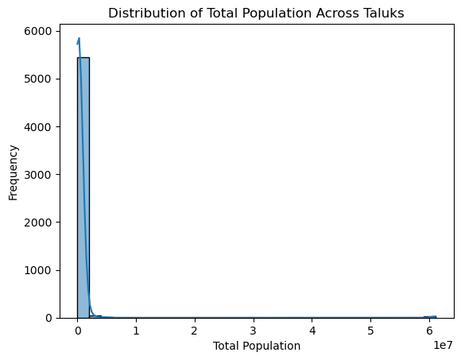
Visualisation 1
This chart compares rural and urban population distributions across
different taluks, highlighting the dominance of rural areas.

Slide 13
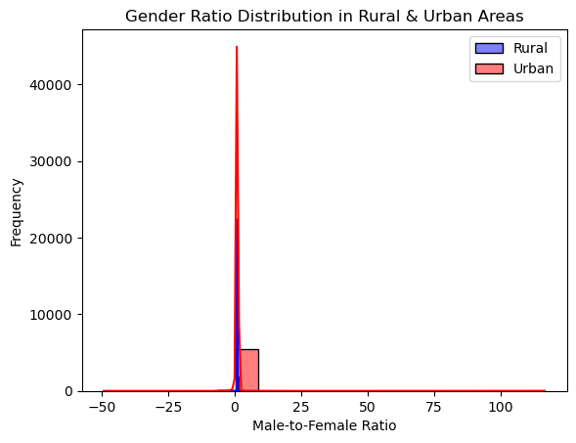
Visualisation 2
A demographic analysis of the gender ratio in rural and urban areas,
showing the distribution of male and female populations.

Slide 14
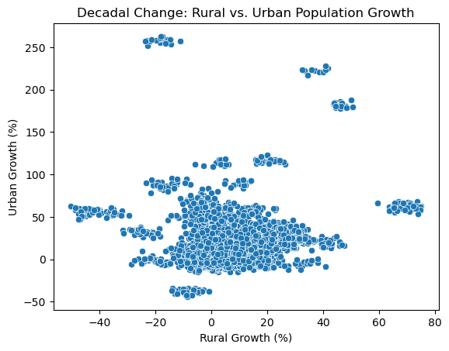
Visualisation 3
This bar chart compares the rural and urban growth rates to identify
which areas have seen faster development.

Slide 15
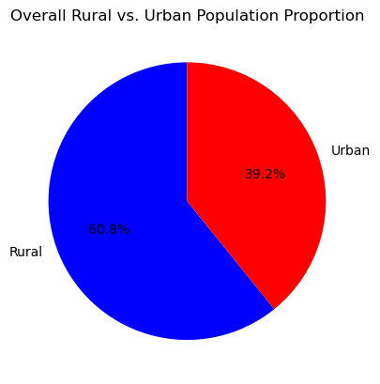
Visualisation 4
A comparative analysis of decadal growth variations, showing
which regions have had increasing or decreasing trends.

Slide 16
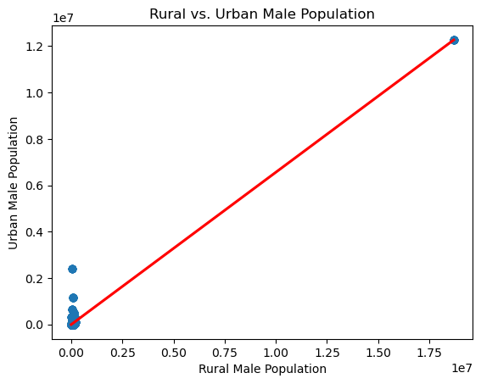
Visualisation 5
A histogram depicting the frequency distribution of rural and
urban populations, helping understand population spread.

Slide 17
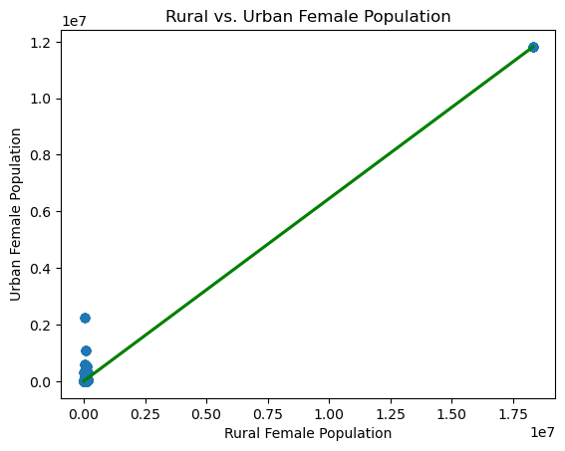
Visualisation 6
A correlation matrix analyzing the relationship between
urbanization levels and population growth trends.

Slide 18
Future Projections
Urbanization is expected to continue increasing.
Rural-to-urban migration will shape population distribution.
Sustainable development is necessary for balanced growth.
Policy interventions can address regional disparities.

Slide 19
Conclusion
This dataset provides valuable insights into population dynamics.
Urbanization trends highlight key migration patterns.
Infrastructure and policy planning are essential for sustainable growth.
Future studies can enhance predictive models for urban expansion.

